Slide 1
Regression for Machine Learning By Yaohang Li, Ph.D. Department of Computer Science Old Dominion University yaohang@cs.odu.edu

Slide 2
Regression
Regression Models
Regression models are used to predict continuous values
Example:
Predicting human height given palm size
Predicting house price given features of a house
Linear regression
Simple linear regression
Multiple linear regression
Multi-variate linear regression
Isotonic regression
Linear regression with polynomial features
Regularization

Slide 3
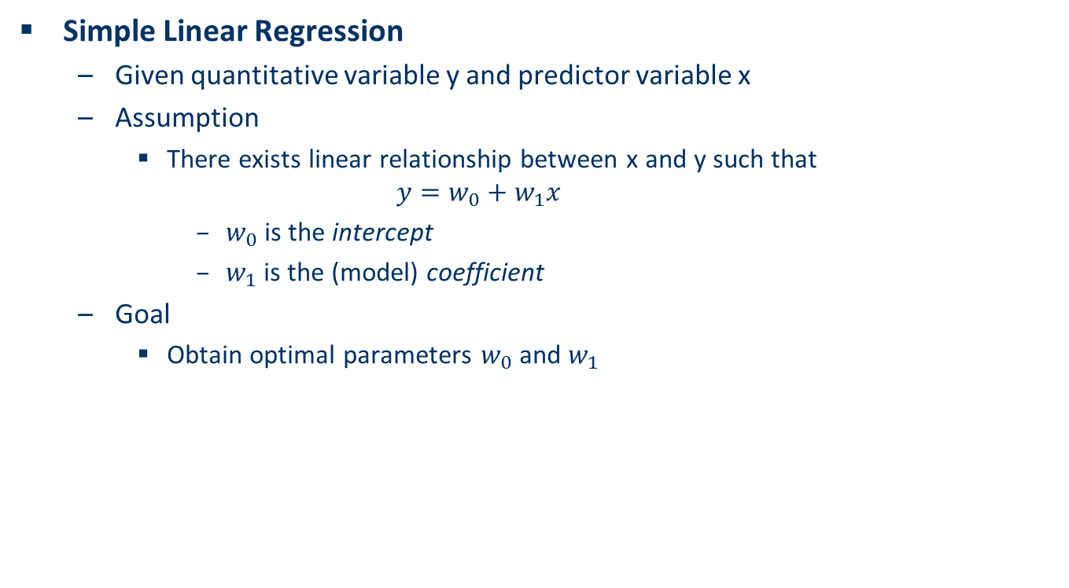
Simple Linear Regression
Simple Linear Regression
Given quantitative variable y and predictor variable x
Assumption
There exists linear relationship between x and y such that
$$y=w_{0}+w_{1}x$$
$w_{0}$ is the intercept
$w_{1}$ is the (model) coefficient
Goal
Obtain optimal parameters $w_{0}$ and $w_{1}$

Slide 4
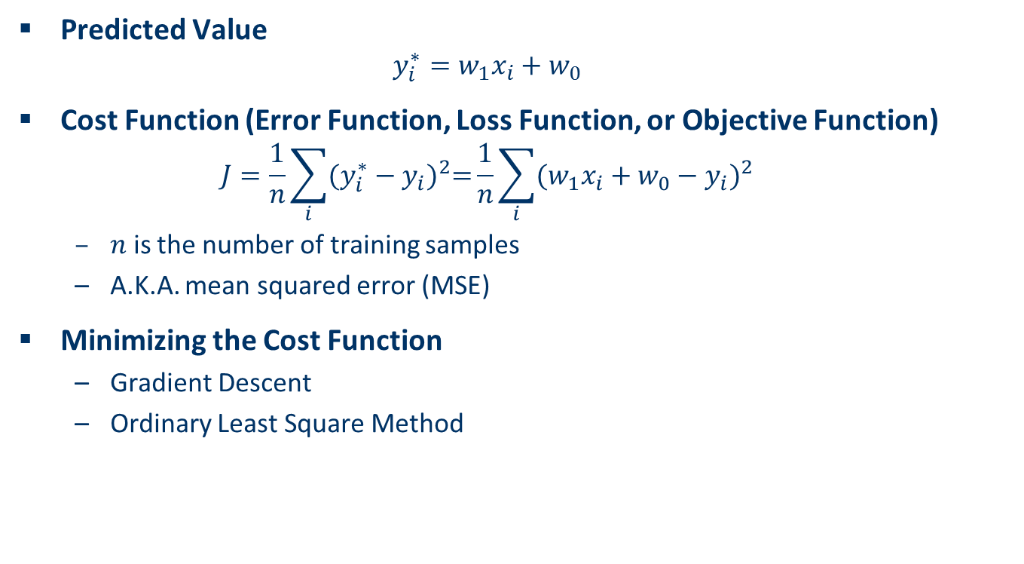
Solving Simple Linear Regression
Predicted Value
$$y_{i}^{∗}=w_{1}x_{i}+w_{0}$$
Cost Function (Error Function, Loss Function, or Objective Function)
$$J=\frac{1}{n}\sum_{i}{{(y_{i}^{∗}−y_{i})}^{2}=}\frac{1}{n}\sum_{i}{{(w_{1}x_{i}+w_{0}−y_{i})}^{2}}$$
$n$ is the number of training samples
A.K.A. mean squared error (MSE)
Minimizing the Cost Function
Gradient Descent
Ordinary Least Square Method

Slide 5
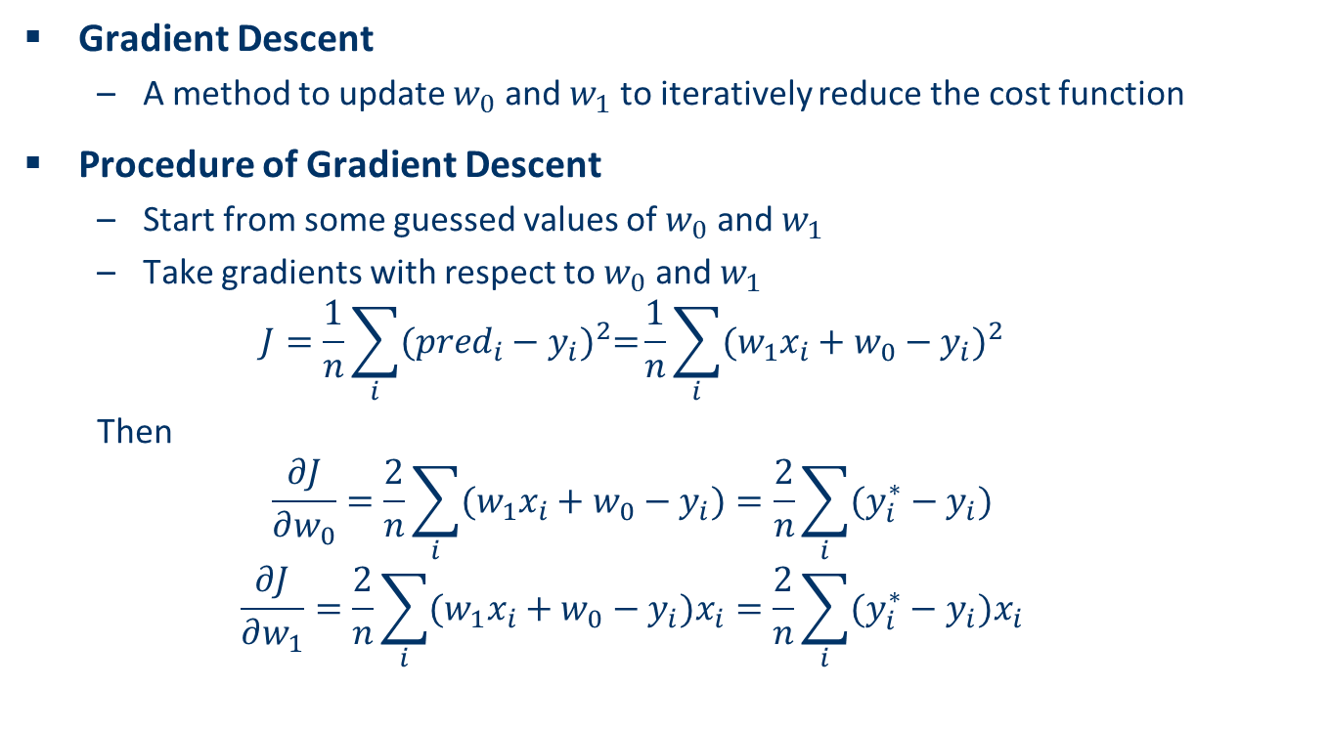
Gradient Descent
Gradient Descent
A method to update $w_{0}$ and $w_{1}$ to iteratively reduce the cost function
Procedure of Gradient Descent
Start from some guessed values of $w_{0}$ and $w_{1}$
Take gradients with respect to $w_{0}$ and $w_{1}$
$$J=\frac{1}{n}\sum_{i}{{({pred}_{i}−y_{i})}^{2}=}\frac{1}{n}\sum_{i}{{(w_{1}x_{i}+w_{0}−y_{i})}^{2}}$$
Then
$$\frac{∂J}{∂w_{0}}=\frac{2}{n}\sum_{i}{(w_{1}x_{i}+w_{0}−y_{i})}=\frac{2}{n}\sum_{i}{(y_{i}^{∗}−y_{i})}$$
$$\frac{∂J}{∂w_{1}}=\frac{2}{n}\sum_{i}{(w_{1}x_{i}+w_{0}−y_{i})x_{i}}=\frac{2}{n}\sum_{i}{(y_{i}^{∗}−y_{i})x_{i}}$$

Slide 6
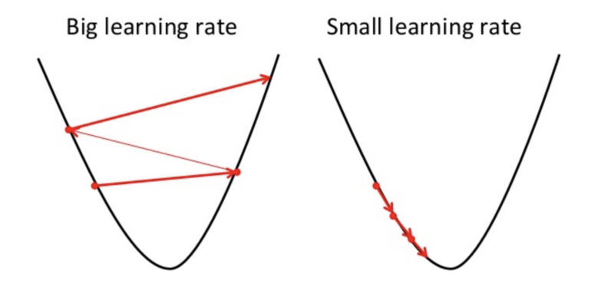
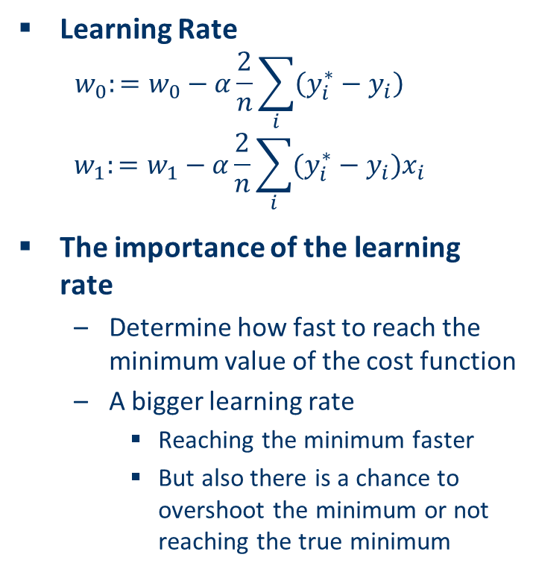
Gradient Descent – Learning Rate
Learning Rate
$$w_{0}:=w_{0}−α\frac{2}{n}\sum_{i}{\left(y_{i}^{∗}−y_{i}\right)}$$
$$w_{1}:=w_{1}−α\frac{2}{n}\sum_{i}{(y_{i}^{∗}−y_{i})x_{i}}$$
The importance of the learning rate
Determine how fast to reach the minimum value of the cost function
A bigger learning rate
Reaching the minimum faster
But also there is a chance to overshoot the minimum or not reaching the true minimum

Slide 7
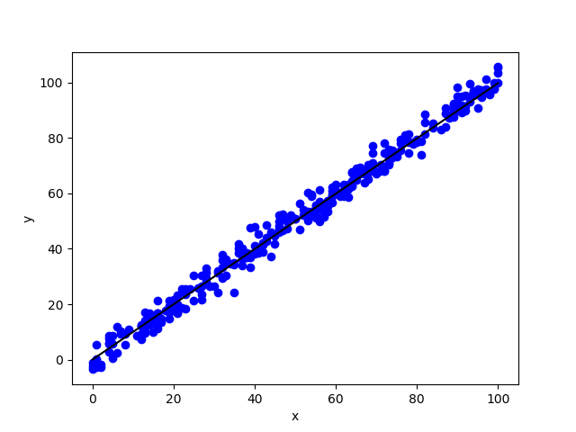
Demo on Kaggle Linear Regression DataSet
Jupyter Notebook simple_regression

Slide 8
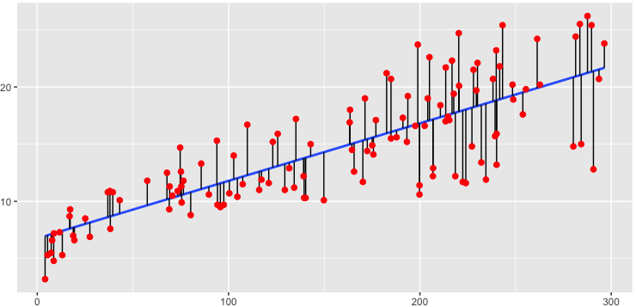
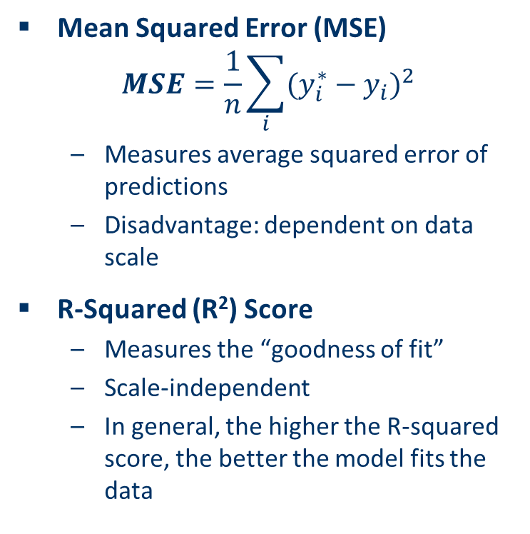
Regression Analysis
Mean Squared Error (MSE)
$$MSE=\frac{1}{n}\sum_{i}{{(y_{i}^{∗}−y_{i})}^{2}}$$
Measures average squared error of predictions
Disadvantage: dependent on data scale
R-Squared (R²) Score
Measures the “goodness of fit”
Scale-independent
In general, the higher the R-squared score, the better the model fits the data

Slide 9
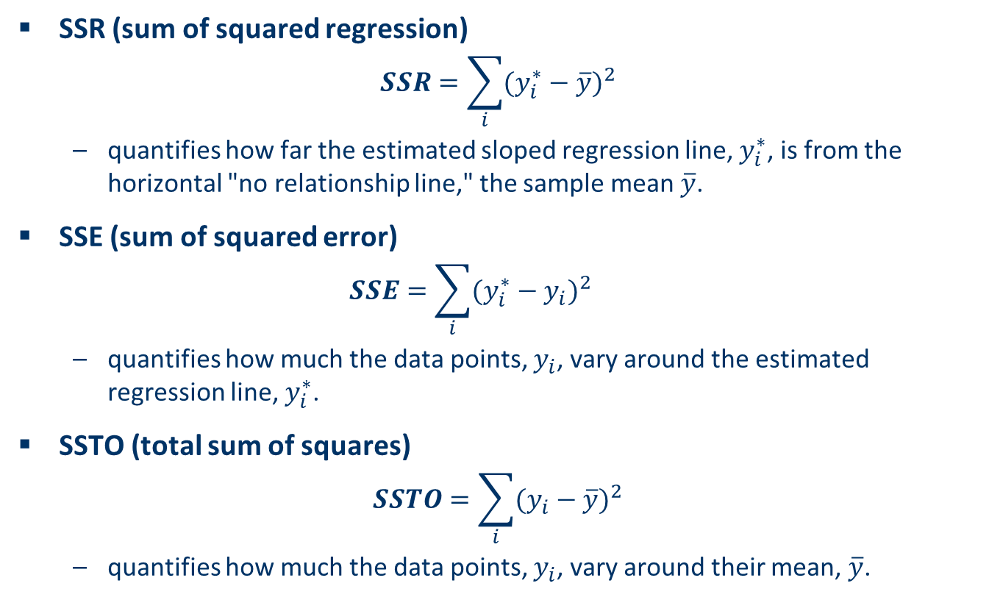
Definition of R-Squared Score
SSR (sum of squared regression)
$$SSR=\sum_{i}{{(y_{i}^{∗}−\overline{y})}^{2}}$$
quantifies how far the estimated sloped regression line, $y_{i}^{∗}$, is from the horizontal "no relationship line," the sample mean $\overline{y}$.
SSE (sum of squared error)
$$SSE=\sum_{i}{{(y_{i}^{∗}−y_{i})}^{2}}$$
quantifies how much the data points, $y_{i}$, vary around the estimated regression line, $y_{i}^{∗}$.
SSTO (total sum of squares)
$$SSTO=\sum_{i}{{(y_{i}−\overline{y})}^{2}}$$
quantifies how much the data points, $y_{i}$, vary around their mean, $\overline{y}$.

Slide 10
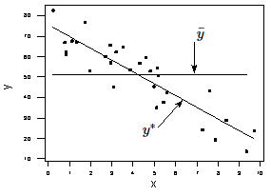
Definition of R-Squared Score (cont.)
SSTO = SSE + SSR
Definition of R-Squared Score
R² = SSR/SSTO = (1 – SSE)/SSTO
between 0 and 1
R² = 1
All of the data points fall perfectly on the regression line
The predictor x accounts for all of the variation in y
R² = 0,
The estimated regression line is perfectly horizontal
The predictor x accounts for none of the variation in y

Slide 11
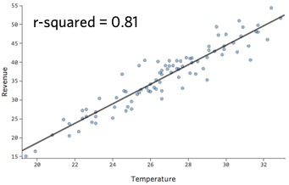
Meaning of R² score
Meaning of R² score
It means “R² ×100 percent of the variation in y is reduced by taking into account predictor x”
This example show that 81% of the variance in Revenue is explained by Temperature

Slide 12
Analysis of R² score
General property of R² score
In general, the higher R² score, the better the model fits the data
However, low R² score doesn’t mean “bad”
Some applications such as psychology, human behavior prediction, etc. expect low R² scores (0.2~0.3)
In some applications such as engineering, low R² scores are not acceptable
Key limitation
R² cannot determine whether the coefficient estimates and predictions are biased

Slide 13
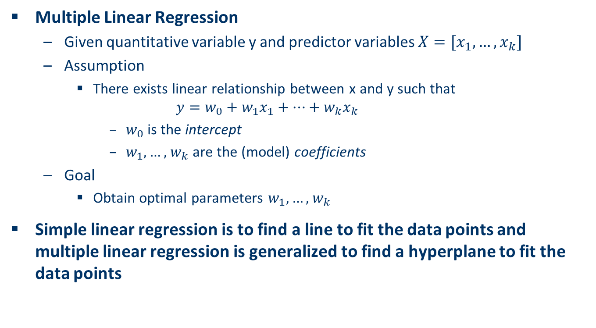
Multiple Linear Regression
Multiple Linear Regression
Given quantitative variable y and predictor variables $X=[x_{1},…,x_{k}]$
Assumption
There exists linear relationship between x and y such that
$$y=w_{0}+w_{1}x_{1}+…+w_{k}x_{k}$$
$w_{0}$ is the intercept
$w_{1},…,$ $w_{k}$ are the (model) coefficients
Goal
Obtain optimal parameters $w_{1},…,$ $w_{k}$
Simple linear regression is to find a line to fit the data points and multiple linear regression is generalized to find a hyperplane to fit the data points

Slide 14
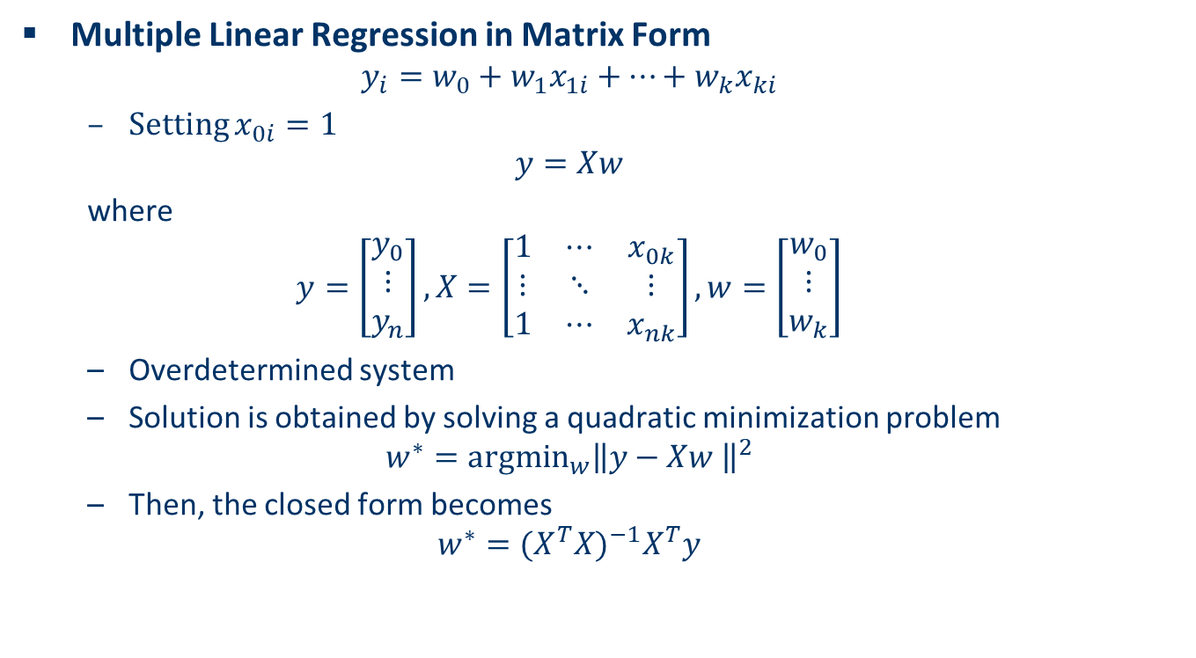
Ordinary Least Square Model
Multiple Linear Regression in Matrix Form
$$y_{i}=w_{0}+w_{1}x_{1i}+…+w_{k}x_{ki}$$
Setting $x_{0i}=1$
$$y=Xw$$
where
$$y=\left[\begin{matrix}y_{0} \\ ⋮ \\ y_{n}\end{matrix}\right],X=\left[\begin{matrix}1 & ⋯ & x_{0k} \\ ⋮ & ⋱ & ⋮ \\ 1 & ⋯ & x_{nk}\end{matrix}\right],w=\left[\begin{matrix}w_{0} \\ ⋮ \\ w_{k}\end{matrix}\right]$$
Overdetermined system
Solution is obtained by solving a quadratic minimization problem
$$w^{∗}={argmin}_{w}{\left\|y−Xw \right\|}^{2}$$
Then, the closed form becomes
$$w^{∗}={(X^{T}X)}^{−1}X^{T}y$$

Slide 15
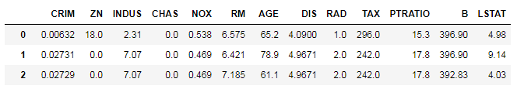
Demo of Multiple Linear Regression
Prediction of Boston House Price
Jupyter notebook multipleregression

Slide 16
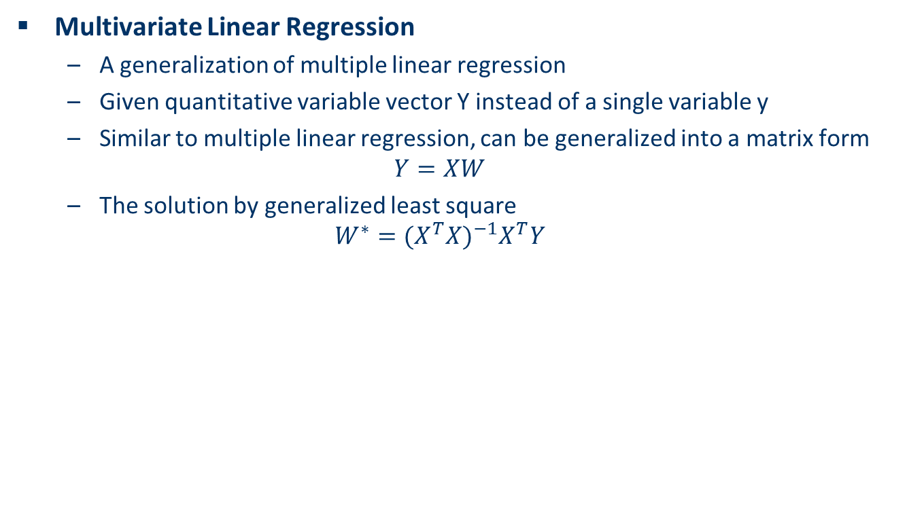
Multivariate Linear Regression
Multivariate Linear Regression
A generalization of multiple linear regression
Given quantitative variable vector Y instead of a single variable y
Similar to multiple linear regression, can be generalized into a matrix form
$$Y=XW$$
The solution by generalized least square
$$W^{∗}={(X^{T}X)}^{−1}X^{T}Y$$

Slide 17
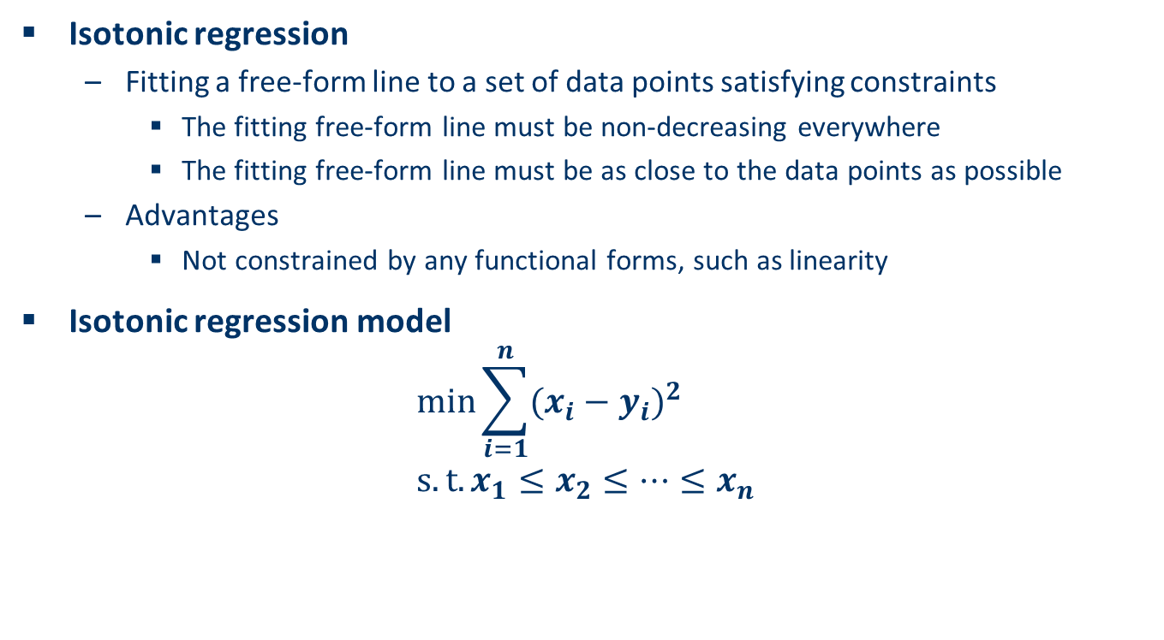
Isotonic regression (monotonic regression)
Isotonic regression
Fitting a free-form line to a set of data points satisfying constraints
The fitting free-form line must be non-decreasing everywhere
The fitting free-form line must be as close to the data points as possible
Advantages
Not constrained by any functional forms, such as linearity
Isotonic regression model
$$\min{\sum_{i=1}^{n}{{(x_{i}−y_{i})}^{2}}} \\ s.t.x_{1}≤x_{2}≤…≤x_{n}$$

Slide 18
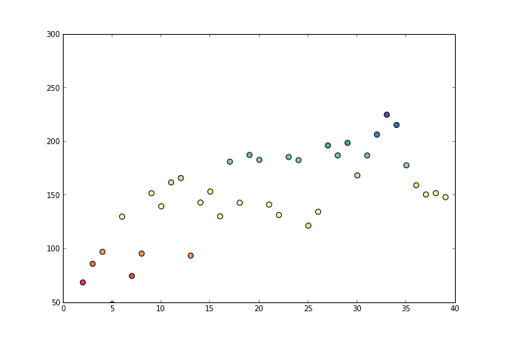
Pool Adjacent Violators Algorithm for Isotonic Regression
Pool Adjacent Violators Algorithm
A Fast O(n) Algorithm
Image obtained from fa.bianp.net

Slide 19
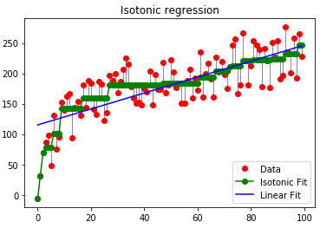
Demo of Isotonic Regression
Jupyter Notebook isotonic_regression

Slide 20
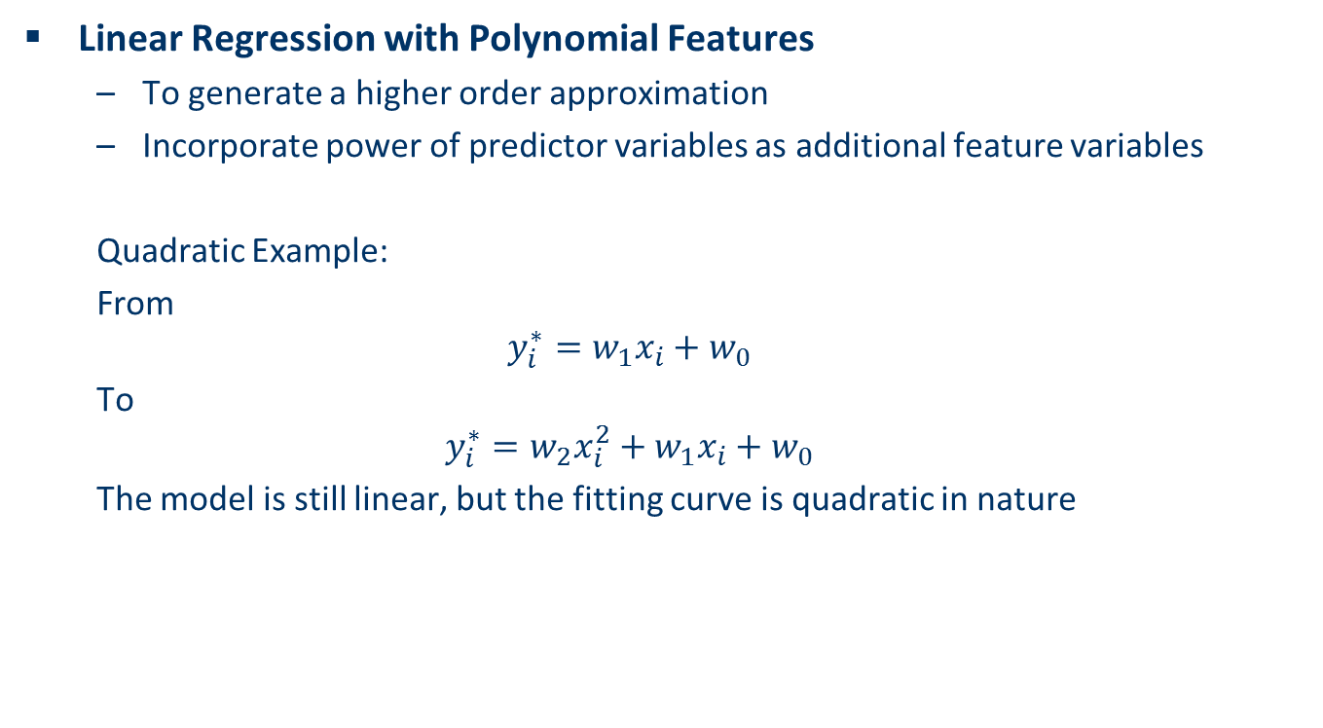
Linear Regression with Polynomial Features
Linear Regression with Polynomial Features
To generate a higher order approximation
Incorporate power of predictor variables as additional feature variables
Quadratic Example:
From
$$y_{i}^{∗}=w_{1}x_{i}+w_{0}$$
To
$$y_{i}^{∗}=w_{2}x_{i}^{2}+w_{1}x_{i}+w_{0}$$
The model is still linear, but the fitting curve is quadratic in nature

Slide 21
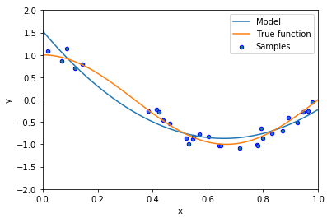
Demo of Linear Regression with Polynomial Features
Jupyter Notebook underfitingandoverfiting

Slide 22
The Overfitting Problem
The Overfitting Problem
Performing a machine learning task on a “small” dataset
The model accurately remembers all training data
Including noise and unrelated features
An overfitting model often performs badly on new test or real data that have not been seen before
Treat the training data too seriously
Simply memorizing everything it has seen
Fail to learn any meaningful pattern out of it
Some slides and figures are adopted from Karatzoglou

Slide 23
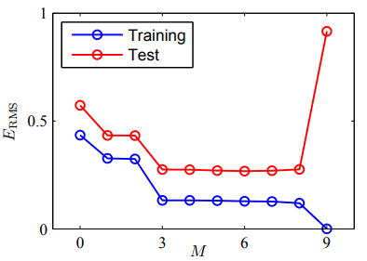
Typical Overfitting Phenomenon

Slide 24
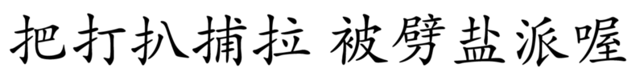

A Trivial Learning Example
Classification of Chinese Characters
Correct Classification
L1 Norm Regularization and Sparsity Explained for Dummies, Shi Yan

Slide 25
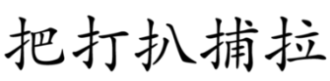


Overfitting in the Trivial Learning Problem
A “too smart” machine learning algorithm
Completely memorize the five characters (too good memory)
as a vector [把, 打, 扒, 捕, 拉]
For a new input
Not in the memory, classify in class 2
Our solution – make the machine learning algorithm “dumber”
[扌, 0, 0, 0, 0]
Sparse vector
L1 Norm Regularization and Sparsity Explained for Dummies, Shi Yan

Slide 26
Regularization
Reduce overfitting by adding a complexity penalty
Regularization
Add penalty on the parameters of the model
Reduce the freedom of the model
The model will be less likely to fit the noise of the training data
Improve generalization abilities of the model

Slide 27
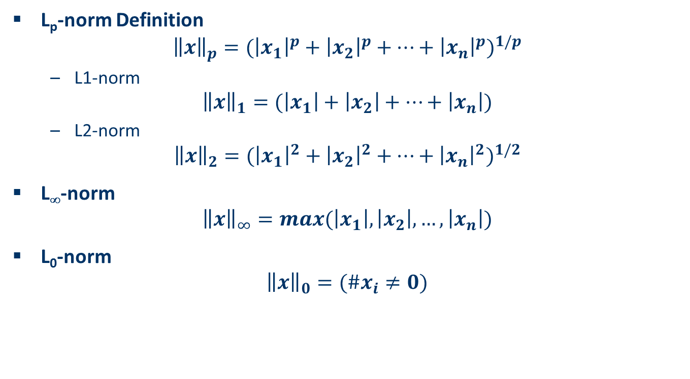
L_{p}-norm
L_{p}-norm Definition
$${\left\|x\right\|}_{p}={({\left|x_{1}\right|}^{p}+{\left|x_{2}\right|}^{p}+…+{\left|x_{n}\right|}^{p})}^{1/p}$$
L1-norm
$${\left\|x\right\|}_{1}=(\left|x_{1}\right|+\left|x_{2}\right|+…+\left|x_{n}\right|)$$
L2-norm
$${\left\|x\right\|}_{2}={({\left|x_{1}\right|}^{2}+{\left|x_{2}\right|}^{2}+…+{\left|x_{n}\right|}^{2})}^{1/2}$$
L∞-norm
$${\left\|x\right\|}_{∞}=max(\left|x_{1}\right|,\left|x_{2}\right|,…,\left|x_{n}\right|)$$
L₀-norm
$${\left\|x\right\|}_{0}=(\#x_{i}≠0)$$

Slide 28
Regularization Model
L1 regularization (Lasso)
L2 regularization (Ridge)
L1/L2 regularization (Elastic net)

Slide 29
L2 Regularization (Ridge Penalization)
L2 regularization will force the parameters to be relatively small
The bigger penalization, the smaller the coefficients are
$${Error}_{L2}=Error+λ\sum_{i=1}^{N}{{|x_{i}|}^{2}}$$

Slide 30
Example of Auto Price Prediction

Slide 31
L1 regularization (Lasso Penalization)
L1 regularization will lead to sparse solution
$${Error}_{L1}=Error+\sum_{i=1}^{N}{λ|x_{i}|}$$

Slide 32
Example of Auto Price Prediction

Slide 33
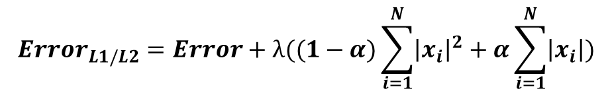
L1/L2 Regularization (Elastic Net)
A combination of L1 and L2 Regularization
Hybrid Behavior of L1 and L2 Regularization
$${Error}_{L1/L2}=Error+λ((1−α)\sum_{i=1}^{N}{{\left|x_{i}\right|}^{2}}+α\sum_{i=1}^{N}{\left|x_{i}\right|})$$

Slide 34
Example of Auto Price Prediction

Slide 35
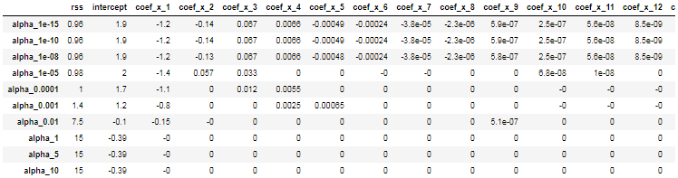
Demo
jupyter Notebook regularization
Jupyter Notebook carprice

Slide 36
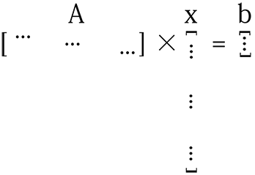
Why L1 Regularization leads to sparse solution?
Let’s consider the problem of optimizing
Ax = b
A is not tall enough
x is very long
L1 Norm Regularization and Sparsity Explained for Dummies, Shi Yan

Slide 37
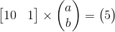
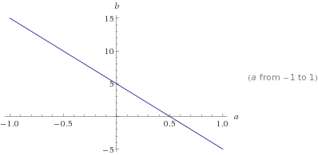
Why L1 Regularization leads to sparse solution?
In particular, consider a 2D system, we only know one data point (training sample)
(10, 5)
The possible solutions lie on the line of b = 5-10*a
Under L1 Regularization, we want to find the solution of the line of b = 5-10*a yielding the smallest L1 norm
L1 Norm Regularization and Sparsity Explained for Dummies, Shi Yan

Slide 38
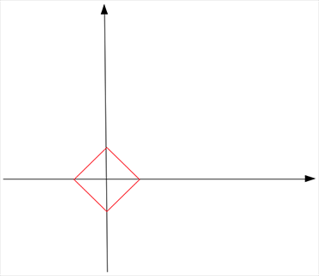
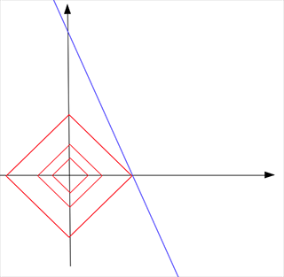
Why L1 Regularization leads to sparse solution?
Now L1 norm looks like
The optimal solution occurs when the L1-norm and b = 10-5*a touch
L1 Norm Regularization and Sparsity Explained for Dummies, Shi Yan

Slide 39
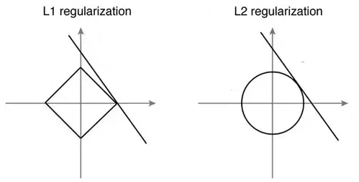
Comparison btw. L1-norm and L2-norm

Slide 40
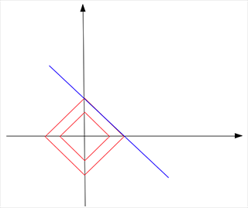
Why L1 Regularization leads to sparse solution?
The optimal solution under L1 Regularization is (0.5, 0)
The solution is sparse because L1 norm is spiky
However, in some situations
L1 Norm Regularization and Sparsity Explained for Dummies, Shi Yan

Slide 41
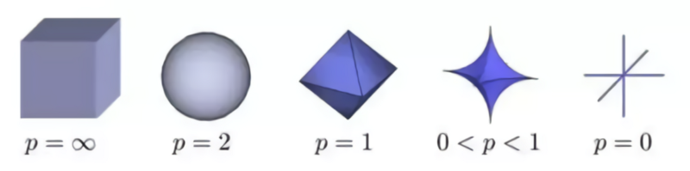
How about more spiky norms?

Slide 42
Mathematics behind regression
Gradient Descent
Simple Linear Regression
Ridge Regression
Coordinate Descent
Lasso Regression

Slide 43
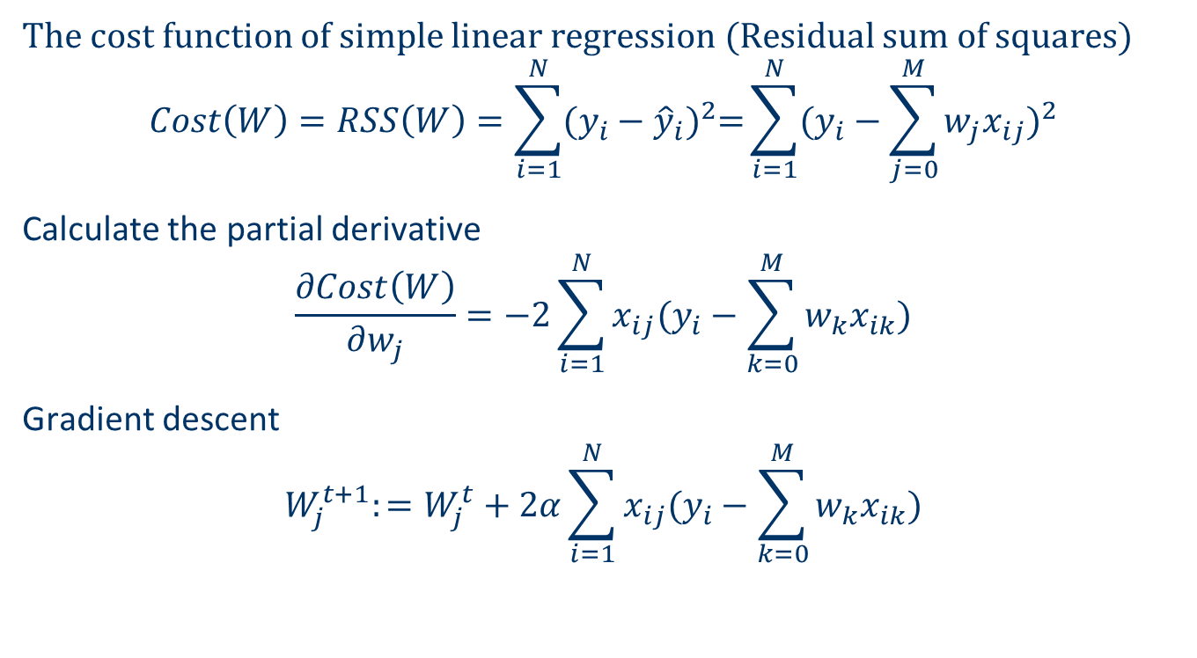
Simple Linear Regression in General
The cost function of simple linear regression (Residual sum of squares)
$$Cost\left(W\right)=RSS\left(W\right)=\sum_{i=1}^{N}{{(y_{i}−{\hat{y}}_{i})}^{2}=}\sum_{i=1}^{N}{{(y_{i}−\sum_{j=0}^{M}{w_{j}x_{ij}})}^{2}}$$
Calculate the partial derivative
$$\frac{∂Cost\left(W\right)}{∂w_{j}}=−2\sum_{i=1}^{N}{x_{ij}(y_{i}−\sum_{k=0}^{M}{w_{k}x_{ik}})}$$
Gradient descent
$$W_{j}^{t+1}:=W_{j}^{t}+2α\sum_{i=1}^{N}{x_{ij}(y_{i}−\sum_{k=0}^{M}{w_{k}x_{ik}})}$$

Slide 44
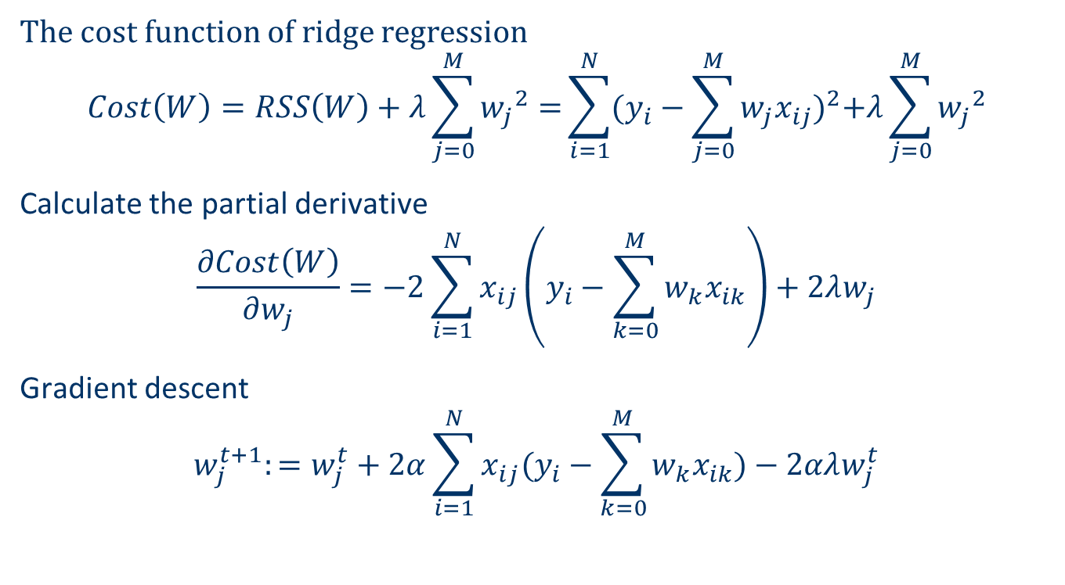
Ridge Regression
The cost function of ridge regression
$$Cost\left(W\right)=RSS\left(W\right)+λ\sum_{j=0}^{M}{{w_{j}}^{2}=}\sum_{i=1}^{N}{{(y_{i}−\sum_{j=0}^{M}{w_{j}x_{ij}})}^{2}+λ\sum_{j=0}^{M}{{w_{j}}^{2}}}$$
Calculate the partial derivative
$$\frac{∂Cost\left(W\right)}{∂w_{j}}=−2\sum_{i=1}^{N}{x_{ij}\left(y_{i}−\sum_{k=0}^{M}{w_{k}x_{ik}}\right)+2λw_{j}}$$
Gradient descent
$$w_{j}^{t+1}:=w_{j}^{t}+2α\sum_{i=1}^{N}{x_{ij}(y_{i}−\sum_{k=0}^{M}{w_{k}x_{ik}})}−2αλw_{j}^{t}$$

Slide 45
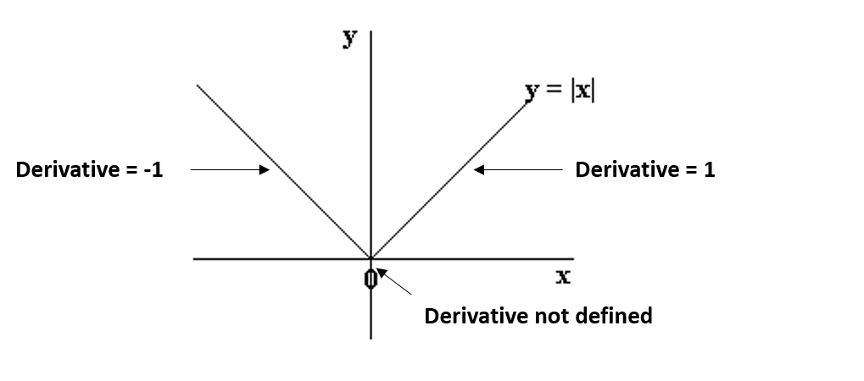
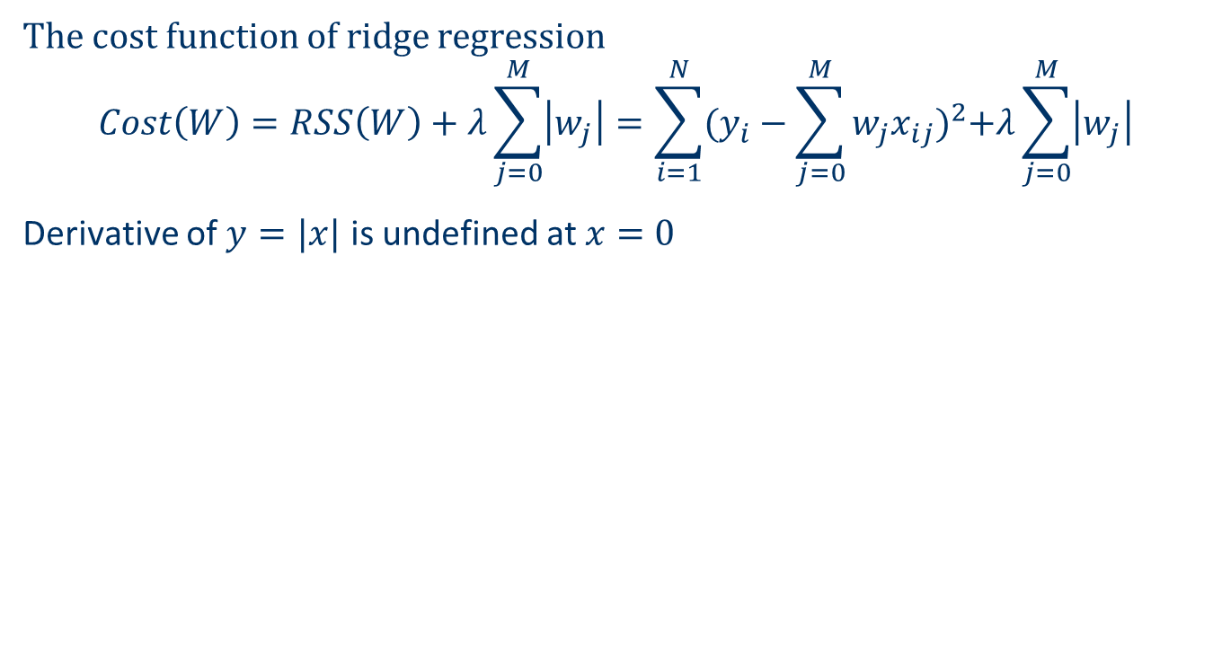
Lasso Regression
The cost function of ridge regression
$$Cost\left(W\right)=RSS\left(W\right)+λ\sum_{j=0}^{M}{\left|w_{j}\right|}=\sum_{i=1}^{N}{{(y_{i}−\sum_{j=0}^{M}{w_{j}x_{ij}})}^{2}+λ\sum_{j=0}^{M}{\left|w_{j}\right|}}$$
Derivative of $y=|x|$ is undefined at $x=0$

Slide 46
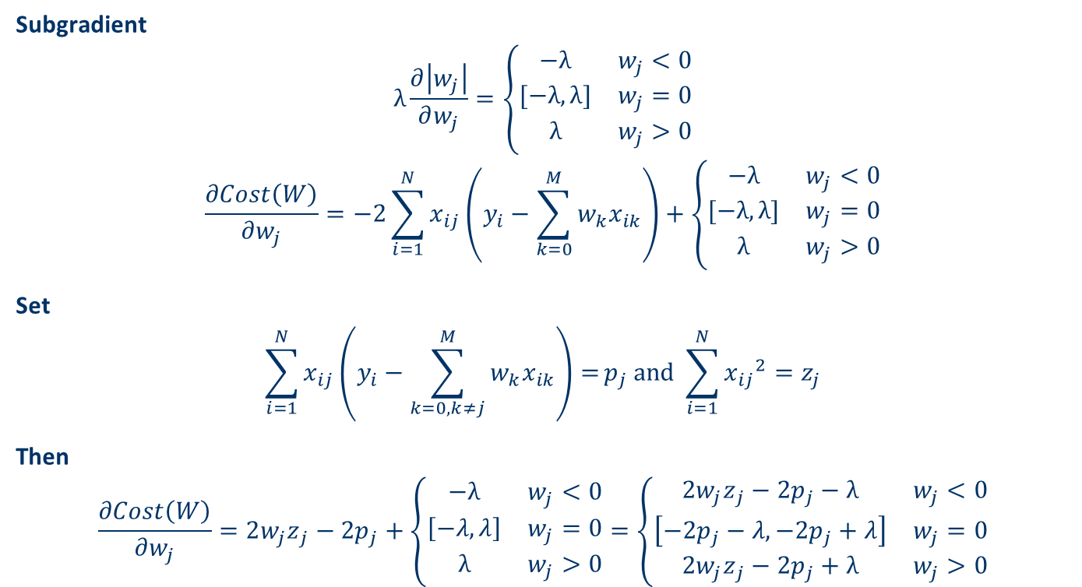
Lasso Regression (cont.)
Subgradient
$$λ\frac{∂\left|w_{j}\right|}{∂w_{j}}=\left\{\begin{matrix}−λ & w_{j}<0 \\ [−λ,λ] & w_{j}=0 \\ λ & w_{j}>0\end{matrix}\right.$$
$$\frac{∂Cost\left(W\right)}{∂w_{j}}=−2\sum_{i=1}^{N}{x_{ij}\left(y_{i}−\sum_{k=0}^{M}{w_{k}x_{ik}}\right)}+\left\{\begin{matrix}−λ & w_{j}<0 \\ [−λ,λ] & w_{j}=0 \\ λ & w_{j}>0\end{matrix}\right.$$
Set
$$\sum_{i=1}^{N}{x_{ij}\left(y_{i}−\sum_{k=0, k≠j}^{M}{w_{k}x_{ik}}\right)=}p_{j} and \sum_{i=1}^{N}{{x_{ij}}^{2}}=z_{j}$$
Then
$$\frac{∂Cost\left(W\right)}{∂w_{j}}=2{w_{j}z}_{j}−2p_{j}+\left\{\begin{matrix}−λ & w_{j}<0 \\ \left[−λ,λ\right] & w_{j}=0 \\ λ & w_{j}>0\end{matrix}\right.=\left\{\begin{matrix}2{w_{j}z}_{j}−2p_{j}−λ & w_{j}<0 \\ \left[−2p_{j}−λ, −2p_{j}+λ\right] & w_{j}=0 \\ 2{w_{j}z}_{j}−2p_{j}+λ & w_{j}>0\end{matrix}\right.$$

Slide 47
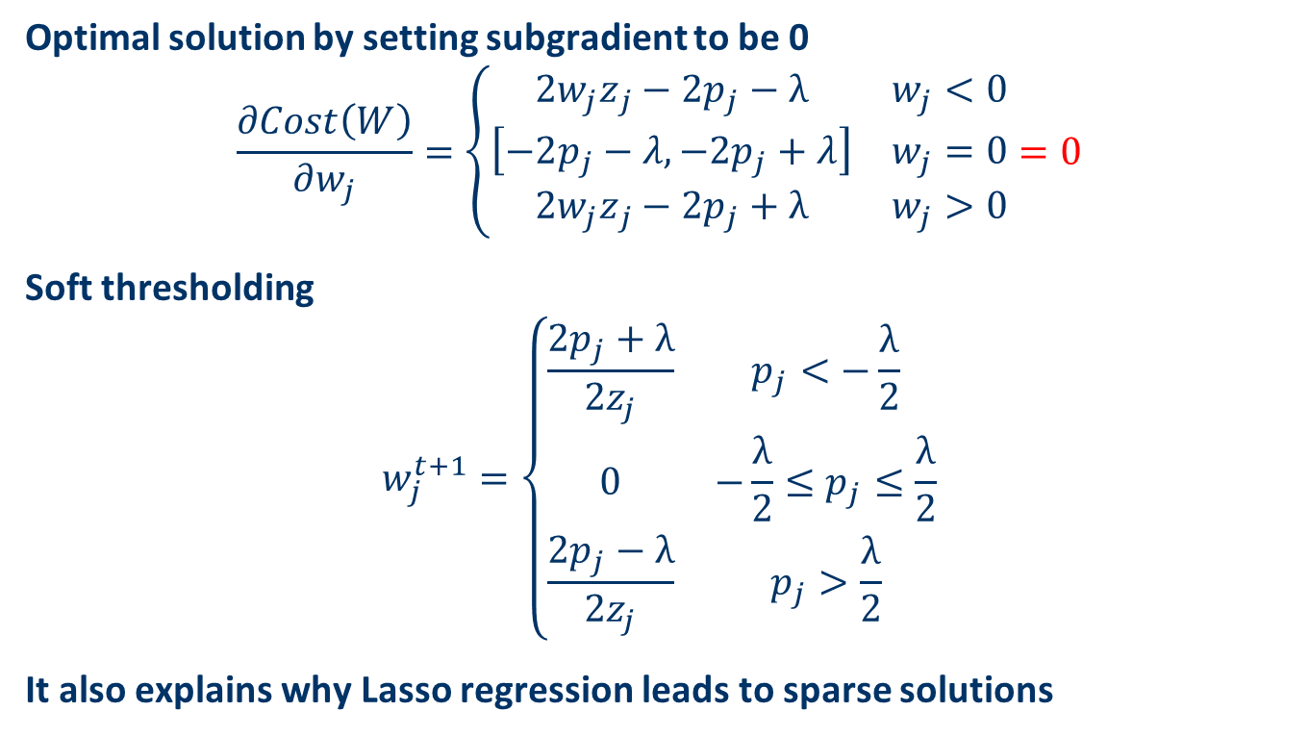
Lasso Regression (cont.)
Optimal solution by setting subgradient to be 0
$$\frac{∂Cost\left(W\right)}{∂w_{j}}=\left\{\begin{matrix}2{w_{j}z}_{j}−2p_{j}−λ & w_{j}<0 \\ \left[−2p_{j}−λ, −2p_{j}+λ\right] & w_{j}=0 \\ 2{w_{j}z}_{j}−2p_{j}+λ & w_{j}>0\end{matrix}\right.=0$$
Soft thresholding
$$w_{j}^{t+1}=\left\{\begin{matrix}\frac{2p_{j}+λ}{2z_{j}} & p_{j}<−\frac{λ}{2} \\ 0 & −\frac{λ}{2}≤p_{j}≤\frac{λ}{2} \\ \frac{2p_{j}−λ}{2z_{j}} & p_{j}>\frac{λ}{2}\end{matrix}\right.$$
It also explains why Lasso regression leads to sparse solutions

Slide 48
Comparison btw. Ridge and Lasso
Usage
Ridge: includes all features to prevent overfitting
Coefficient shrinkage (model complexity reduction)
Computational challenges in handling a lot of features
Lasso: to provide sparse solutions
Feature selection
Computational advantage when handling a lot of features
Presence of highly correlated features
Ridge: works well since all of them are involved
Coefficients are distributed according to correlation of the features
Lasso: does not work as well as Ridge since only one feature will be selected
Elastic Net
Balancing the advantages and disadvantages of Ridge and Lasso

Slide 49
Summary
Regression models for machine learning
Linear regression
Simple linear regression
Multiple linear regression
Multi-variate linear regression
Isotonic regression
Linear regression with polynomial features
Regularization
Lasso
Ridge
Elastic Net

